Slide 1
Case Management for Children and Pregnant Women
Judy Branham
Medicaid Medical and Dental Benefits Policy
Health and Human Services Commission
July 25, 2024

Slide 2
Introduction
Texas Health & Human Services Commission (HHSC) Children & Pregnant Women (CPW) Staff
Jennifer Daniels
Medical and Dental Benefits Policy, Manager
Office of Policy, Medicaid & CHIP Services
Judy Branham
Medical and Dental Benefits Policy, Program Specialist
Office of Policy, Medicaid & CHIP Services
Kriselda Tello
Medical and Dental Benefits Policy, Program Specialist
Office of Policy, Medicaid & CHIP Services

Slide 3
House Bill (H.B.) 1575 (88R) Summary
Managed care organizations (MCOs) and Thriving Texas Families (TTF) screen pregnant women for non-medical health-related needs and coordinate services or refer to CPW provider
Pregnant women must opt-in to non-medical screening
MCOs and TTF share results with HHSC
Community Health Workers (CHWs) and doulas will be new providers of Medicaid case management for CPW services
Expanded provider training for CPW services
Reports sent to the Legislature every two years, to include birth outcomes – beginning December 1, 2024

Slide 4
H.B. 1575 Timeline
Sept. 2023
Dec. 2023 – Feb. 2024
June 2024
Fall-Winter 2024
Fall-Winter 2024
HHSC drafts screening questions
HHSC finalizes screening questions
Doula and CHW begin CPW training
Doulas & CHW enrollment period in PEMS
Doulas & CHWs can submit claims for CPW services
Oct. – Nov. 2023
Jan. – Aug. 2024
Sept. 2024
Fall 2024
Dec. 2024
MCOs & other stakeholders give HHSC feedback
HHSC drafts / finalizes MCO contract requirements (UMCC & UMCM)
MCOs and TTF start screening & sending results to HHSC
HHSC reports back to Legislature
Contract & SPA revisions effective

Slide 5
Certification and Credentialing
Community Health Workers (CHWs)
Certified by DSHS.
HHSC is coordinating with DSHS to ensure:
Proof of certification for existing CHWs.
Sufficient resources are available to train new CHWs interested in enrollment.
Doulas
HHSC has developed credentialing criteria for enrollment.
Stakeholder feedback received and evaluated.
Two pathways: experience or training.

Slide 6
Doula Credentialing Criteria: Experience Pathway
Five years of experience as a doula.
Standardized case management training.
HIPAA training.
18 years of age.
Attendance in three births.
Three professional letters of recommendations.

Slide 7
Doula Credentialing Criteria: Training Pathway
For providers without five years of experience:
Training that meets core competency requirements.
Standardized case management training.
HIPAA training.
18 years of age.
Attendance in three births.
Three professional letters of recommendations.

Slide 8
Core Competencies for Training Pathway
Childbirth education
Nonmedical comfort measures, prenatal support, and labor support techniques.
Chronic and acute health conditions during the perinatal period.
Cultural competency training
Lactation support. Or show proof of being a Certified Lactation Counselor (CLC) or International Board-Certified Lactation Consultant (IBCLC).

Slide 9
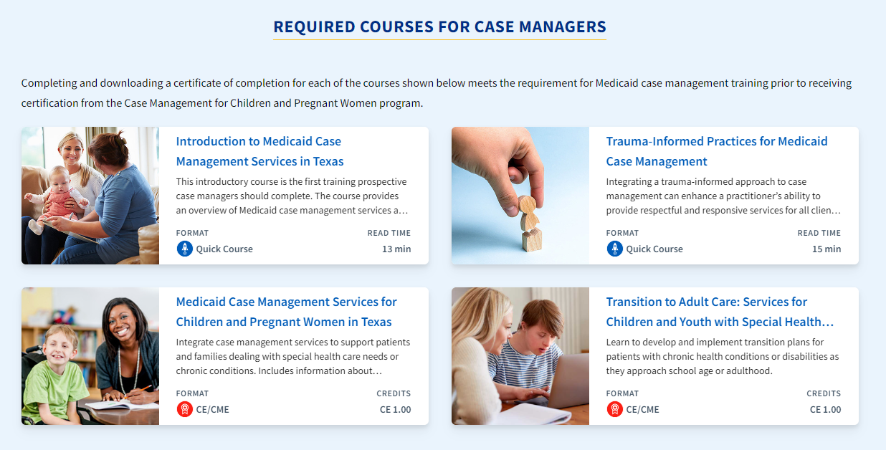
Required Training: All CPW Providers
Standardized HHSC case management courses include:
A total of four courses (self-paced online) need to be completed with certificate proof of completion prior to enrolling for two-day case management focused courses.
Case Manager | Texas Health Steps (txhealthsteps.com)

Slide 10
Required Training: All CPW Providers
Standardized HHSC case management courses include:
Two half-day trainings are required after the online certificates are completed.
Instructor-led, virtual courses
Email ASKCM@hhs.texas.gov to request enrollment information
Next trainings are scheduled for: August 21-22, 2024

Slide 11
CPW Provider Enrollment and Claims
New CPW Provider Enrollment
Complete the pre-planning and training requirements.
An approval letter to enroll with Texas Medicaid and Healthcare Partnership (TMHP) as a CPW Medicaid provider will be issued.
CHW and Doula provider types to be added to the Provider Enrollment Management System (PEMS).
Targeting Fall-Winter 2024 to begin PEMS enrollment and claims submittal.
Providers can begin accepting referrals for fee-for-service members when system changes are complete.

Slide 12
CPW Provider Enrollment
CPW providers enroll through the TMHP.com Provider Enrollment Management System (PEMS).

Slide 13
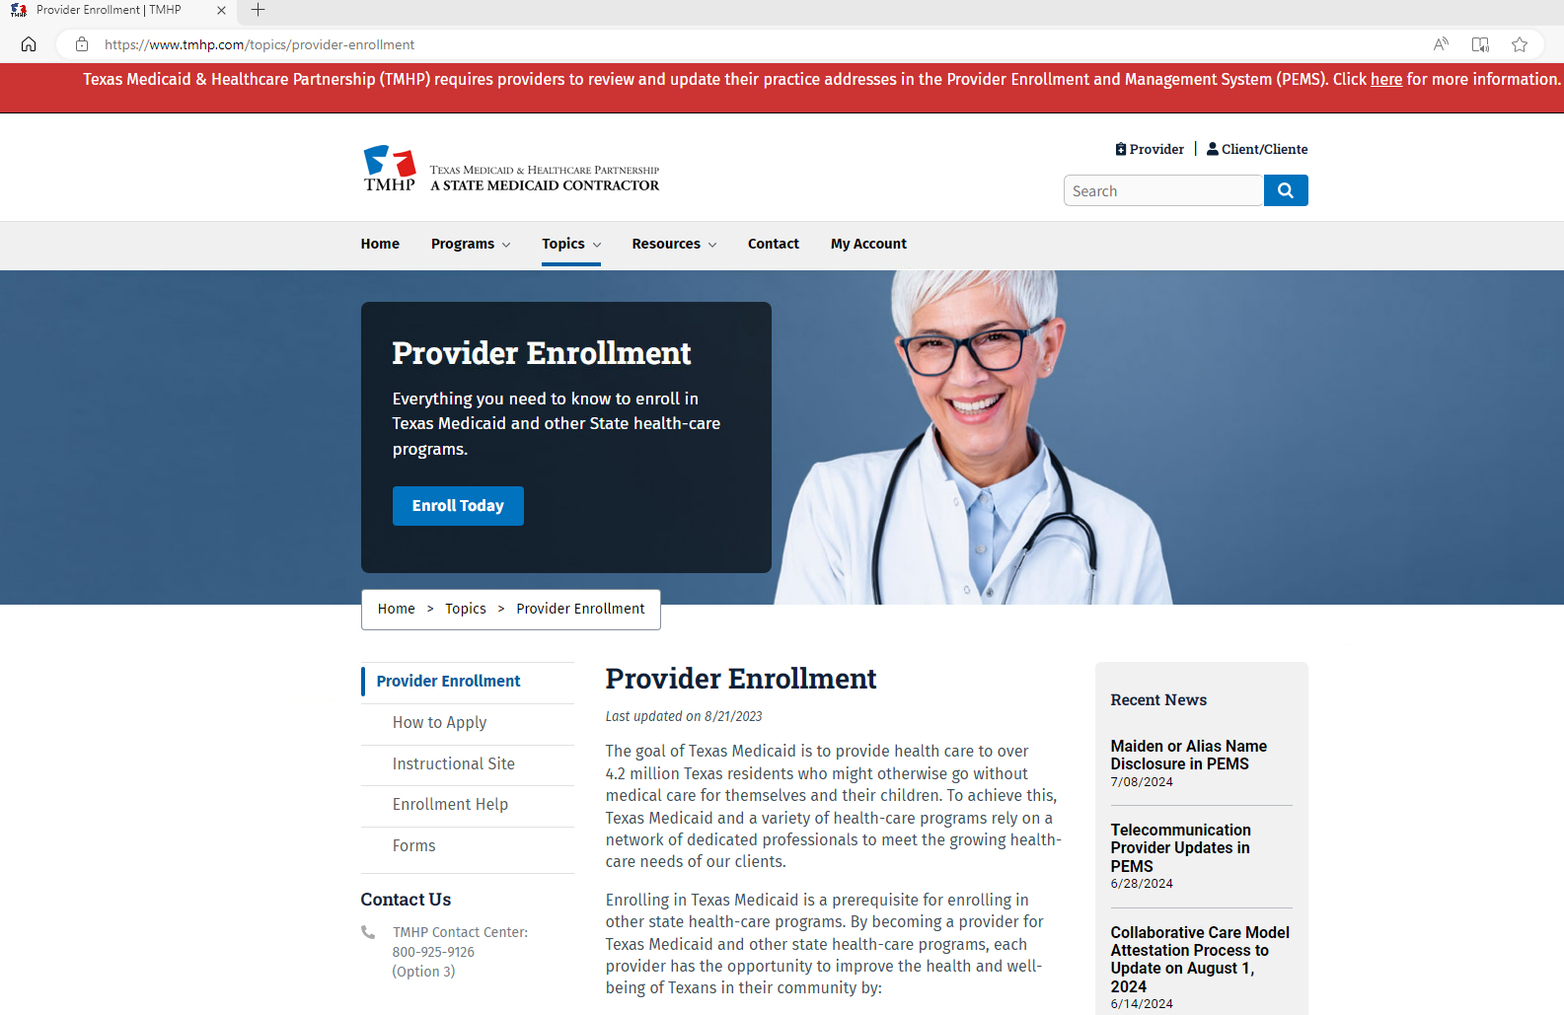
CPW Provider Enrollment
This section provides enrollment help and contact numbers
https://www.tmhp.com/topics/provider-enrollment

Slide 14
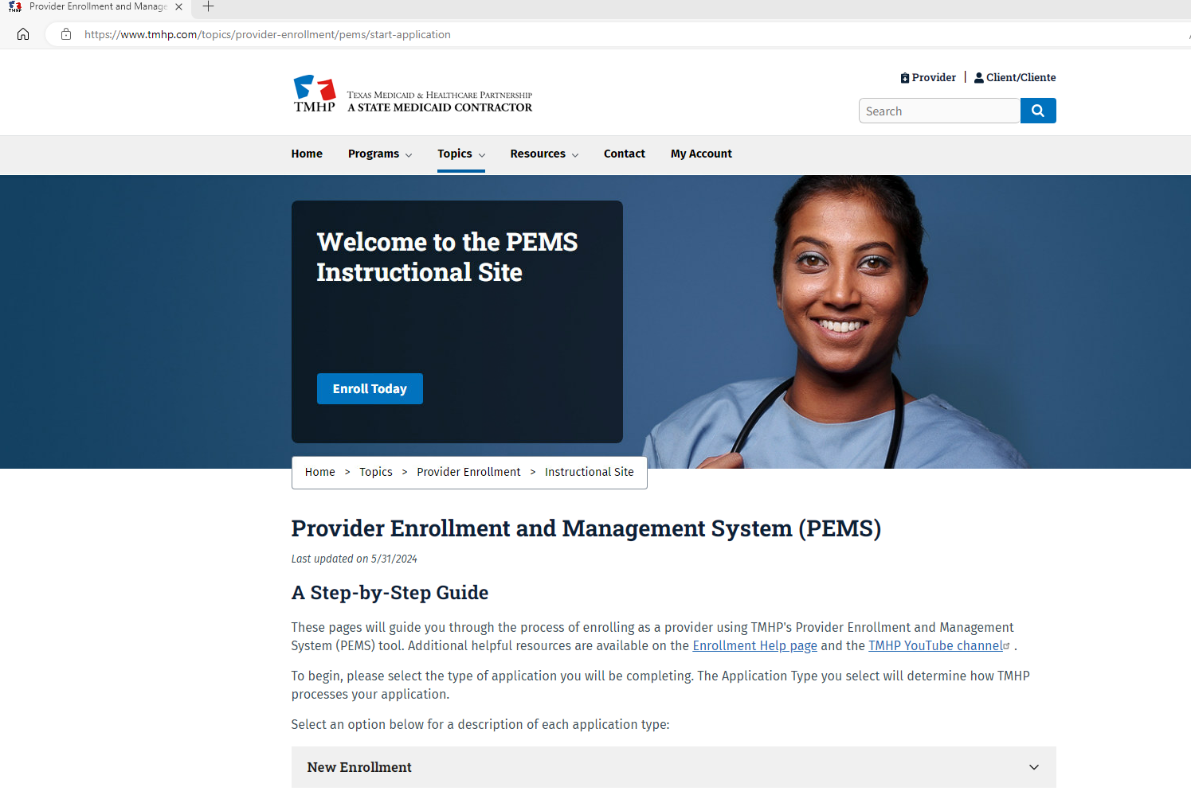
CPW Provider Enrollment Application
A step-by-step guide supports the enrollment process as well
https://www.tmhp.com/topics/provider-enrollment/pems/start-application

Slide 15
CPW MCO Provider Network
CPW Providers must contract and be credentialed with a MCO to provide Medicaid managed care services.
A CPW Provider Resources guide assists with credentialing and contacts within each MCO for assistance. https://tahp.org/library/cpw-credentialing-provider-resource/
Rates are negotiated between the CPW provider and the MCO.
An MCO's rate may differ from the Medicaid fee-for service (FFS) fee schedule.
Authorization requirements and claims processing might be different between MCOs.
MCOs are not required to follow the Medicaid FFS prior authorization processes.

Slide 16
Out-of-Network (OON) Providers
If providers choose not to contract with MCOs in the service area, then the providers won’t be part of the MCOs’ provider networks.
Sometimes, the MCO might be willing to sign a single-case agreement or enter into a limited contractual relationship.
This allows the provider to treat a single Medicaid patient.
The provider must check with individual MCOs for details.

Slide 17
How Will I Know What MCO My Clients Are In?
All Medicaid managed care members get a MCO ID card, in addition to a Your Texas Benefits Medicaid card from HHSC.
The member’s MCO ID card includes:
Member’s name and Medicaid ID number.
Medicaid program (e.g., STAR, STAR Kids).
MCO name.
Primary care provider name and phone number.
Toll-free phone numbers for member services and behavioral health services hotline.
The member should have this information available to share with you.

Slide 18
How Do I Submit Claims (1 of 2)?
TexMedConnect is used by CPW providers to submit claims directly. https://www.tmhp.com/sites/default/files/file-library/edi/Portal-Security-Manual.pdf
Review the Portal Security Training Manual that provides instructions on:
Portal security responsibilities.
Account activation - Requesting a Personal Identification Number (PIN).
Managing user accounts and permissions.
Resetting passwords.

Slide 19
How Do I Submit Claims (2 of 2)?
TexMedConnect is used by CPW providers to submit claims directly. https://www.tmhp.com/sites/default/files/file-library/edi/Portal-Security-Manual.pdf
Upon reviewing the Portal Security Training Manual:
Complete and submit an Electronic Data Interchange (EDI) Agreement.
Complete the trading partner testing.
Submit claims using Procedure Code G9012, Taxonomy 374J00000X for Doula and 172V00000X for CHW.
Claims can be submitted using the CMS-1500 paper claim form.

Slide 20
How Much Time Do I Have to Submit Claims?
TMHP must receive claims within 95 days of the date of service.
CPW providers should verify client eligibility. Not all clients currently have a Medicaid identification number.
If a client becomes retroactively eligible, the 95-day filing deadline begins on the date that the eligibility start date was added to TMHP files.
Claims for clients in managed care must be submitted to the client’s MCO.
Once an error-free claim is received, then MCOs are required to pay the claim within the 30-Days or notify the CPW provider of the reason for denial.

Slide 21
What is the Fee-for-Service Reimbursement Rate for CPW Services?
Comprehensive Visit - $146.16
Follow-Up Visit In-Person - $122.31
Follow-Up Visit Audio-only – $29.36

Slide 22
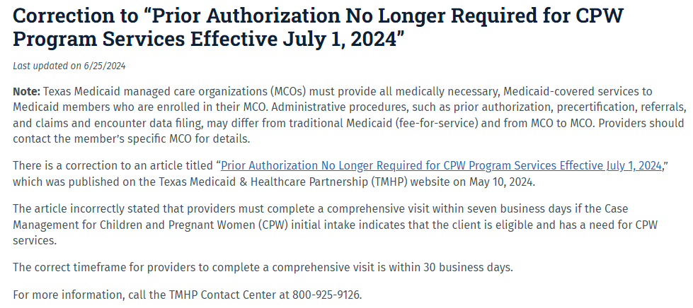
CPW Program Operations (1 of 5)
Prior authorizations (PAs) were discontinued on July 1, 2024 and are no longer required for FFS. MCOs have flexibility to determine their own administrative processes, such as requiring PA.
Reasons for discontinuance of FFS PA:
Volume of FFS PAs drastically declined.
Streamlined process better supports retroactive eligibility.
Provider Notice Link: https://www.tmhp.com/news/2024-06-25-correction-prior-authorization-no-longer-required-cpw-program-services-effective

Slide 23
CPW Program Operations (2 of 5)
CPW providers role in providing services, especially under the following conditions:
Urgent assistance is needed.
Assistance with program denials (e.g., social security income).
Domestic violence.
Legal services.
Child Protective Services involvement.
Admission, review, and dismissal meetings.
Locating childcare.
Food insecurity.

Slide 24
CPW Program Operations (3 of 5)
Uniform Managed Care Manual 16.1
MCOs must include CPW Providers in the MCO’s Provider Network.
MCOs require professional liability insurance by CPW providers.
A CPW Provider who is a CHW or doula provides the same scope of CPW services as all other CPW Providers.
MCOs must determine that there is no duplication of services.
MCOs must first pay and seek recovery from third parties.
UMCM Chapter 16.1 link: https://www.hhs.texas.gov/sites/default/files/documents/laws-regulations/handbooks/umcm/16-1.pdf

Slide 25
CPW Program Operations (4 of 5)
Uniform Managed Care Manual 16.1, Federally Qualified Health Centers (FQHCs)
FQHCs are eligible to participate under their own FQHC provider type, specialty code, and taxonomy code.
FQHC prospective payment system wrap payment methodology applies to CPW services.
New case managers for FQHCs only need to complete the standardized case management training to be eligible to provide services.
Training is a requirement.

Slide 26
CPW Program Operations (5 of 5)
HB 1575 Uniform Managed Care Contract
As required by H.B. 1575 (88R), MCOs must:
Use a standardized screening for non-medical needs of pregnant members.
Screen for food, transportation, housing, and childcare needs.
Obtain informed consent by the member.
Determine if a member requires a more comprehensive assessment.
Complete a referral to services within 30 days of assessment, if appropriate.
Report to HHSC the results of the screening.

Slide 27
Recent Policy Changes (1 of 2)
State Plan Amendment (SPA)
Proposed amendment to implement H.B. 1575 (2023):
Adds CHWs and doulas to serve as case management providers.
Establishes provider qualifications for CHWs and doulas.
Aligns sections of the State Plan related to CPW.

Slide 28
Recent Policy Changes (2 of 2)
Texas Administrative Code (TAC)
Proposed rule amendments include:
Moving CPW rules from Title 25 (DSHS) to Title 26 (HHSC).
Adding H.B. 1575 (88R; 2023) requirements.
Updating language to match operational processes.
Proposed draft rules were posted for informal comment.
April 9 through April 18, 2024.
Proposed draft rules will be published in the Texas Register in the near future.
GovDelivery Notification link: https://service.govdelivery.com/accounts/TXHHSC/subscriber/new

Slide 29
Resources
Case Management for CPW Website: https://www.hhs.texas.gov/providers/health-services-providers/case-management-providers-children-pregnant-women
TMHP Website: https://www.tmhp.com
Texas Medicaid Provider Procedures Manual Website: https://www.tmhp.com/resources/provider-manuals/tmppm
Texas Health Steps Case Management Training Website: Case Manager | Texas Health Steps (txhealthsteps.com)

Slide 30
Thank You!
Judy Branham
AskCM@hhs.texas.gov

